Slide 1
Career Development
1st Grade

Slide 2
Career Cluster
What is a “Career”?
  A person’s WORK or JOB
  Most people work for 30 years or longer
  Wow! That’s a long time!
What is a “Career Cluster”?
  A way to organize careers or jobs into groups that are similar

Slide 3
Agriculture, Food, and
Natural Resources
Today, we will focus on the Agriculture, Food, and Natural Resources career cluster
Where does our food come from?
Where are some places you can find animals?
How many of you have pets?
How do you take care of your pets?

Slide 4
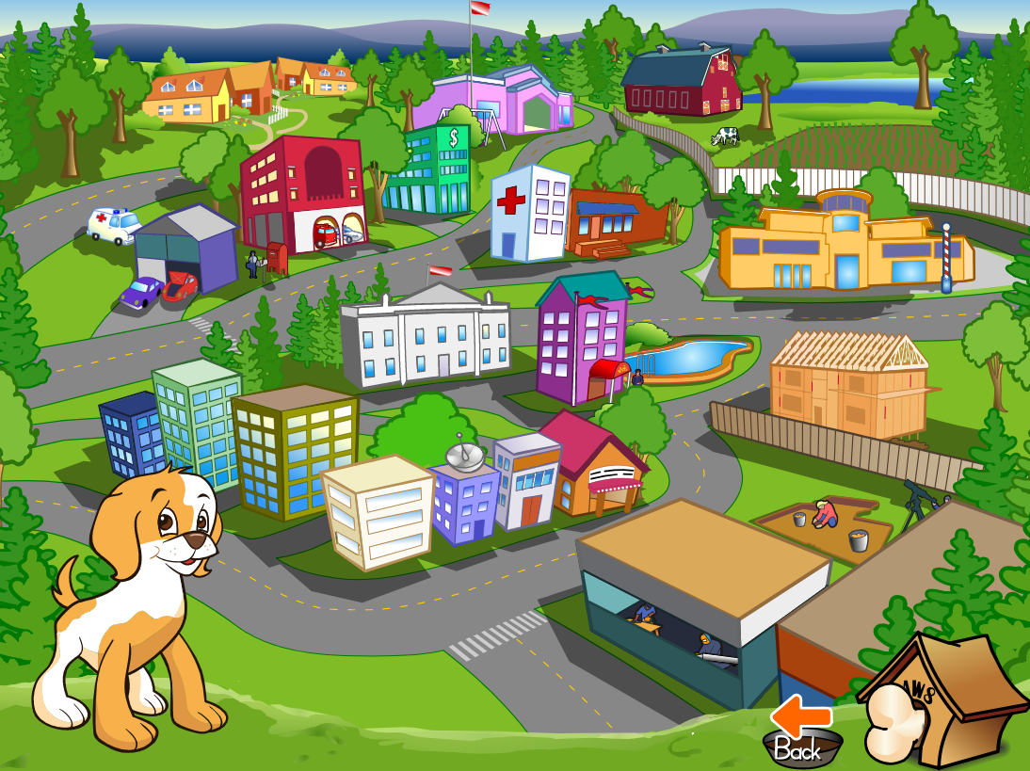
Paws in Jobland
Does anyone know what you call an animal doctor?
A Veterinarian is an occupation in the Agriculture cluster.
Switch to Paw’s website browser-tab
Notes:
Veterinarian – On the website, you

Slide 5

Transportation, Distribution, and Logistics
Jobs related to:
  Transportation
  How things get from one place to another
Ship
Train
Tractor Trailer
Airplane

Slide 6
Transportation
How do you get to school?
Car
School Bus
Mini Van

Slide 7
Paws in Jobland
Transportation Careers
  Pilot
  Bus Driver
  Mechanic
  Truck Driver
  Ambulance Driver
Switch to Paw’s website browser-tab

Slide 8
Law, Public Safety,
Corrections & Security
This cluster includes occupations that keep us safe and protect us from having bad things happen to our homes, families, and towns.
What types of jobs do you think people do to keep us safe?

Slide 9

Who protects me?
Who would help me if a robber was in my house?
Judge
Police
Firefighter

Slide 10
Who protects me?
Who would help me if I needed help in court?
Judge
Lifeguard
Soldier

Slide 11
Who protects me?
Who would help me if I was having trouble swimming in a pool?
Firefighter
Judge
Lifeguard

Slide 12
Who protects me?
Who would help if my house was on fire?
Police
Judge
Firefighter

Slide 13
Paws in Jobland
Public Safety Careers
  Police
  Firefighters
  Ski Patrol
  Park Ranger
Switch to Paw’s website browser-tab

Slide 14
What Do YOU Want to Be?
Before you know it you will be in high school—like me!
It is important to have an idea of what you want to do when you grow up.
In high school, you will be able to take classes to help you prepare for a CAREER!

Slide 15
What Do YOU Want to Be?

